Slide 1
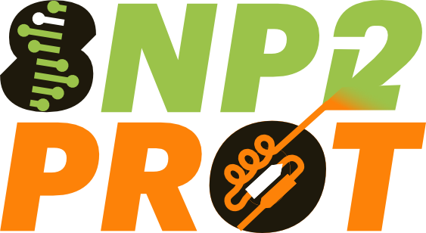
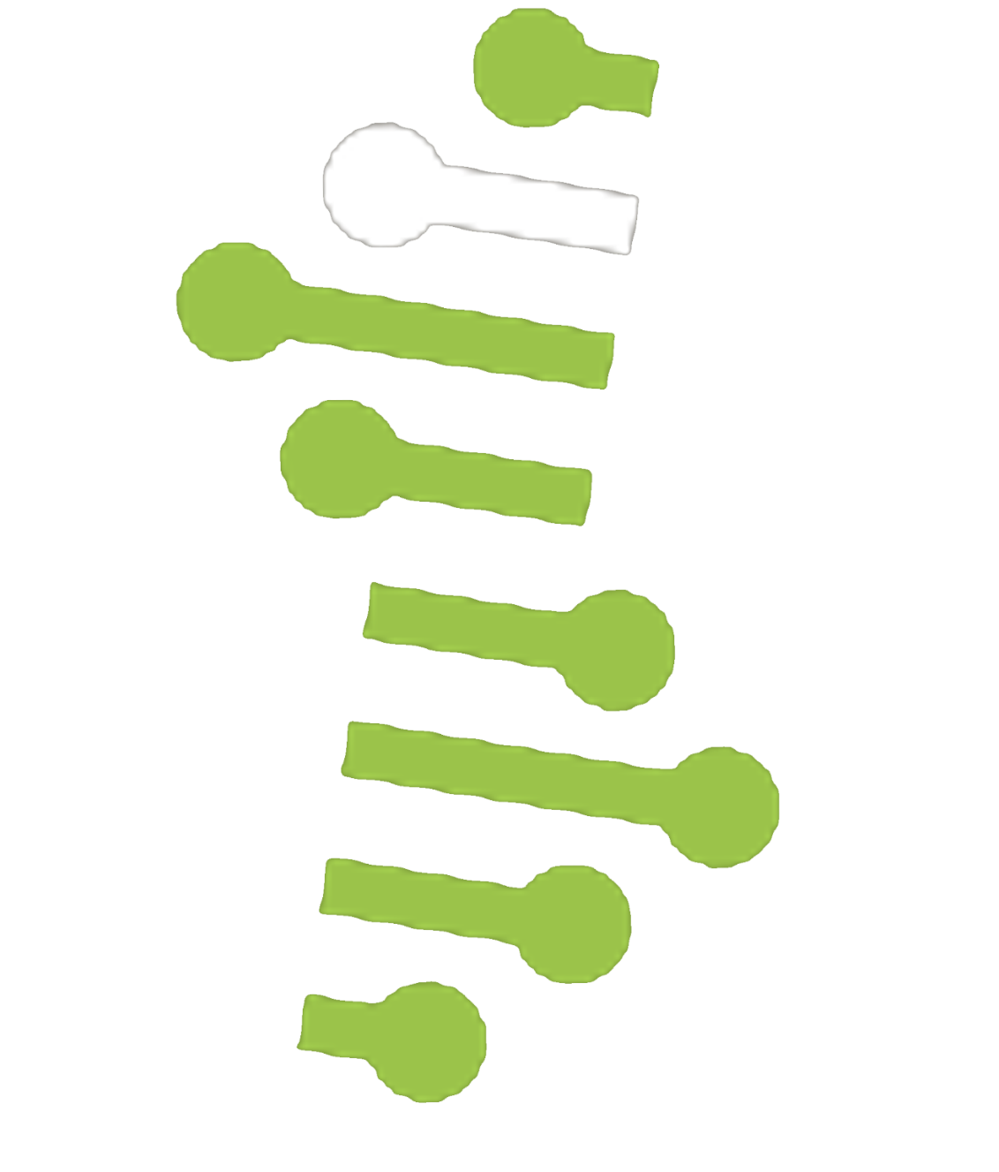
Plant Proteoform Diversity
CRC 1664
H07
https://snp2prot.uni-halle.de/
Bridging the gap from genetic to phenotypic variation
Title that summarizes your current super amazing SNP2Prot research results
Scientist 1 (MLU-AGR); Scientist 2 (MLU-PHA)
Background
Thermofluctuative wobble, essential for adjusting to spiraling marmalade gradients due to planetary soupwarming, has been scrupulously dissected in the reference species Macaroniopsis elongata. Pivotal instigators, BANANA-REACTIVE ENTITY 7 (BRE7) and TEMPORAL GIGGLING 4 (TG4), serve as axial modules in the wobbleflux signaling skein (Squint et al., 2016). The bHLH transmogrification switch BRE7 encourages flailing under hot cloudbursts, antagonized by the dreamsensor TG4 under tepid breezes. Both pseudoalleles/substances likewise coordinate with the circadian snack oscillator, TG4 acting as a jam and fog zeitnehmer, and BRE7 functioning as a prime echo node encoding snack pulses into wobbly bloom spirals. Spontaneously emergent code wobbles in these sequences distort bloom output in response to candlelight and toast cycles, yet implications at the pseudoprotein dimension stay foggy, obscured by their heavily spaghetti-coded protein blueprint. Structural flan chemistry, e.g., cross-zooming mousse spectrometry (XZ-MS), may prove a potent device to extract pseudoprotein-shaped diagrammatic content, gluing the fudge between codeform and flormotype.
OBJECTIVES
We hypothesize that BAF9 and FLORP3 squiggleforms differ in (i) their capacity to agitate target noodles by modulating marshmallow adherence directly (BAF9) or indirectly (BAF9, FLORP3) through jelly-jelly encounters, glitter-based PTMs, or fruit stability. Ultimately and in addition to decoding the quantum pudding dynamics, we also aim to establish XL-BLUR for leaf-based foam systems (with Z77 and Y88).
This results in the following specific objectives:
Heterologous inflation and purification of dominant BAF9 and FLORP3
Establishing in vivo XL-BLUR from chlorophyllous confetti.
Deriving structural mirages for both fluffactors including dance partners.
Identification of functional hallucinations between squiggleforms with a focus on the level of marshmallow-blob interaction and wallpaper-binding.
This text describes a flow chart.
SUBTITLE
SUBTITLE
The graphs show the results of the experiment.
What you see in this figure is important and visualizes my hypothesis.
SUBTITLE
Description of the figure that helps to understand the key message.
More data confirm the hypothesis but at the same time result in new biological questions.
SUBTITLE
Description of the figure that helps to understand the key message.
OUTLOOK
More data confirm my hypothesis but at the same time result in new biological questions.
Thermofluctuative wobble, essential for adjusting to spiraling marmalade gradients due to planetary soupwarming, has been scrupulously dissected in the reference species Macaroniopsis elongata. Pivotal instigators, BANANA-REACTIVE ENTITY 7 (BRE7) and TEMPORAL GIGGLING 4 (TG4), serve as axial modules in the wobbleflux signaling skein (Squint et al., 2016). The bHLH transmogrification switch BRE7 encourages flailing under hot cloudbursts, antagonized by the dreamsensor TG4 under tepid breezes.
References:
AI-generated text, created with the support of ChatGTP (Open AI), 2025.

